Slide 1

Introduction to Complex Numbers
Complex numbers are a fundamental concept in mathematics, extending the real number system to include imaginary components.
Farjan Ahmmed
232-35-738

Slide 2
Real and Imaginary Parts
Z = a + ib
Real Part
Imaginary Part
The real part of a complex number represents the actual, measurable quantity, like distance or time. It can be positive, negative or zero.
The imaginary part of a complex number is represented by the square root of -1, denoted as "i". It describes quantities that cannot be directly measured.

Slide 3
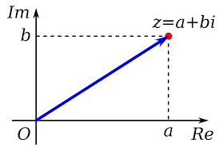
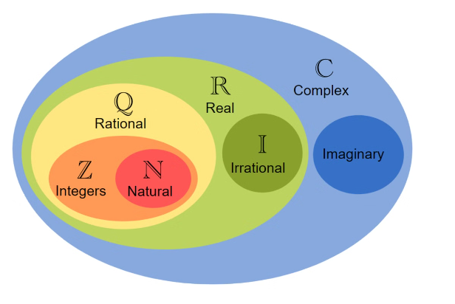
Representation of Complex Numbers
Complex numbers are represented in the form a + bi, where a is the real part and b is the imaginary part. The imaginary unit i is defined such that i^2 = -1.
This representation allows complex numbers to be visualized on the complex plane, where the real part is plotted on the horizontal axis and the imaginary part is plotted on the vertical axis.

Slide 4


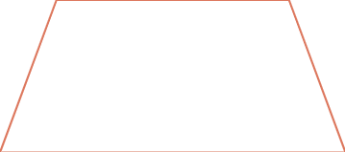

Arithmetic Operations with Complex Numbers
Addition
1
Adding the real and imaginary parts separately
2
Subtraction
Subtracting the real and imaginary parts separately
3
Multiplication
Applying the distributive property
Division
4
Using the conjugate to cancel the imaginary part
The four basic arithmetic operations - addition, subtraction, multiplication, and division - can be performed on complex numbers by treating the real and imaginary parts separately. This allows complex numbers to be manipulated just like real numbers, following established algebraic rules and properties.

Slide 5
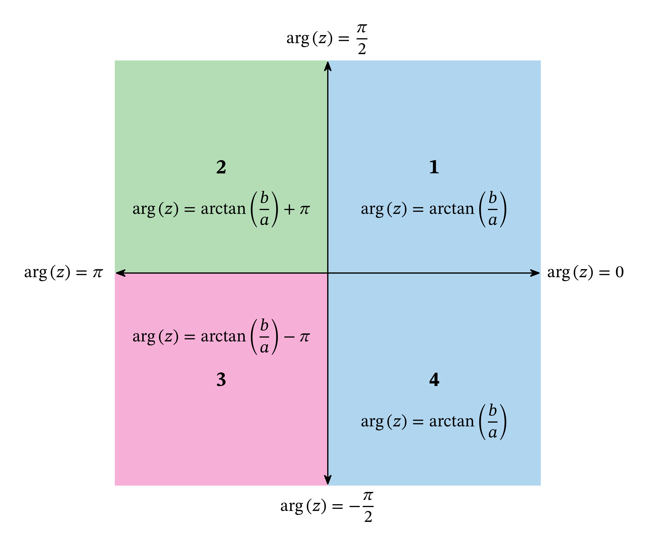
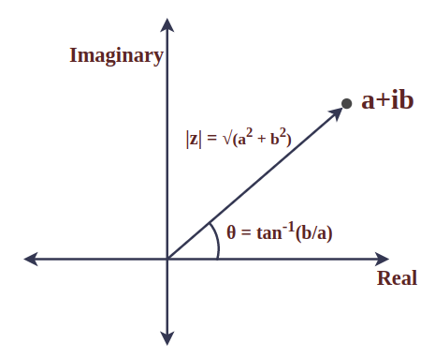
Modulus and Argument of Complex Numbers
Modulus
Argument
The modulus of a complex number represents its absolute value or magnitude. It is denoted by |z| and calculated as the square root of the sum of the squares of the real and imaginary parts.
The argument of a complex number is the angle it makes with the positive real axis. It is denoted by arg(z) and can be found using the inverse tangent function.
Polar Coordinates
Complex numbers can be represented in polar form using the modulus and argument. This provides a useful alternative to the rectangular (real and imaginary) representation.

Slide 6
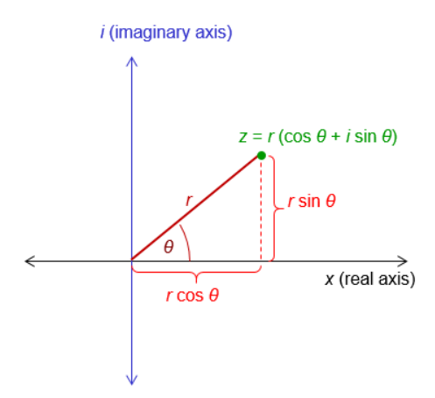
Polar Form of Complex Numbers
Complex numbers can be represented in polar form, where the number is expressed in terms of its modulus and argument. This provides a more intuitive way to visualize and perform operations on complex numbers.
The polar form of a complex number z = a + ib is given as z = r(cos θ + i sin θ), where r is the modulus |z| and θ is the argument (arg z) of the complex number.

Slide 7
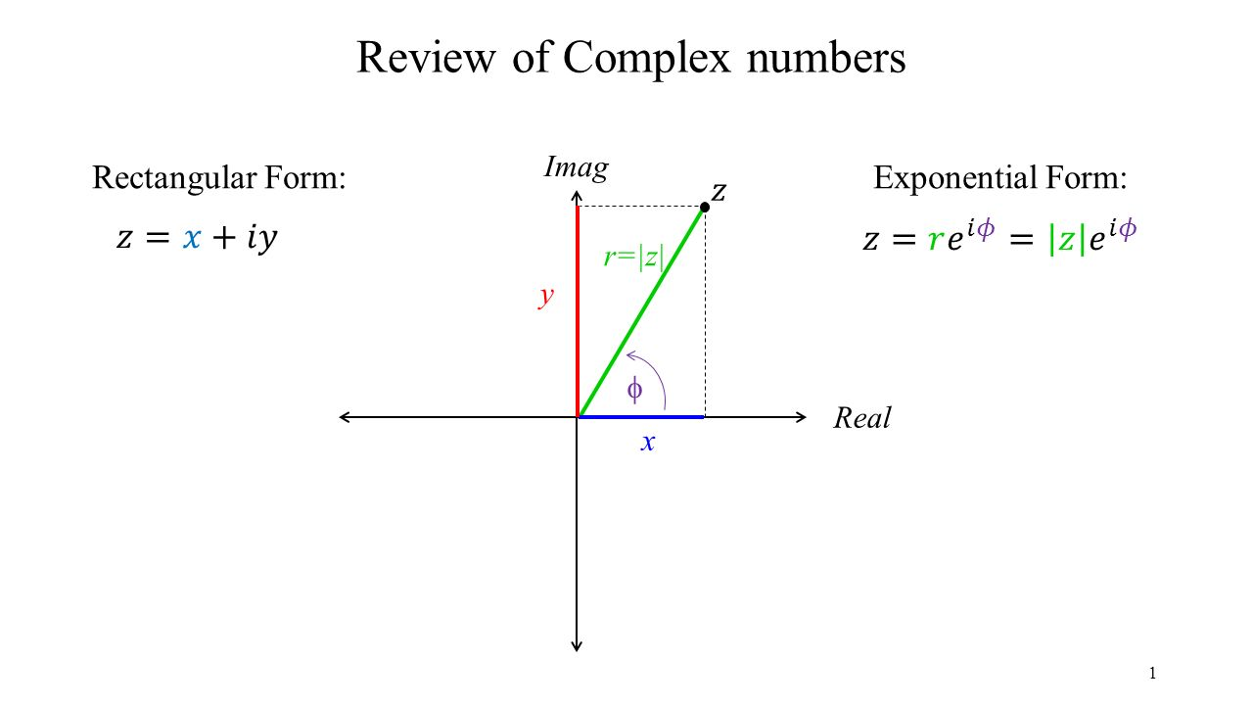
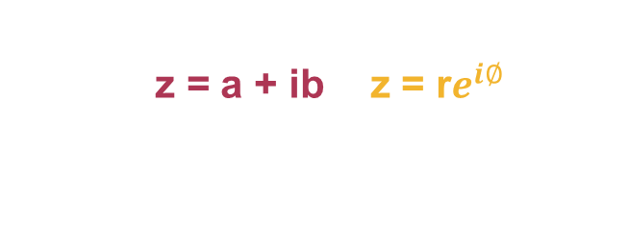
Exponential Form of Complex Numbers
Polar Representation
Exponential Notation
Complex numbers can be expressed in polar form using the modulus and argument. This representation is known as the exponential form.
Advantages
The exponential form simplifies complex arithmetic operations like multiplication, division and raising to a power, making it a powerful tool in mathematics and engineering.

Slide 8
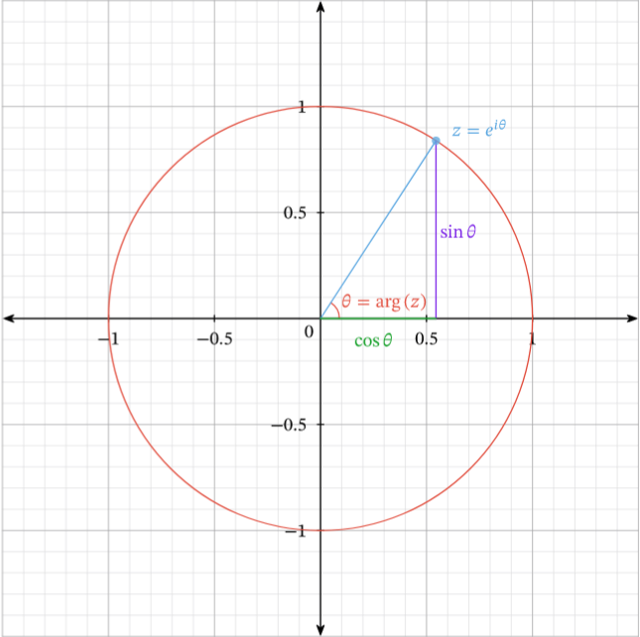
Applications of Complex Numbers
Complex numbers have numerous applications in various fields, including engineering, physics and mathematics. They are used in the analysis of electrical circuits, signal processing, quantum mechanics and mathematical modeling of complex phenomena.
Complex numbers also play a crucial role in the study of functions, allowing for a more comprehensive understanding of their behavior and properties. Additionally, they find applications in computer graphics, cryptography and even music composition.

Slide 9

Conclusion
In conclusion, complex numbers have proven to be an invaluable tool in mathematics, providing a powerful framework for solving a wide range of problems. The ability to represent and manipulate complex numbers has led to advancements in fields such as engineering, physics and computer science.

Slide 10
Thank You

